Slide 1

Introduction to Android
Dilman A. Salih
University of Halabja
Slides: 3,4,15,16,17,18, … to the end.

Slide 2

Outline
What is Android?
History of Android
iPhone vs. Android
Developer Revenues
Android Architecture
Android Features

Slide 3
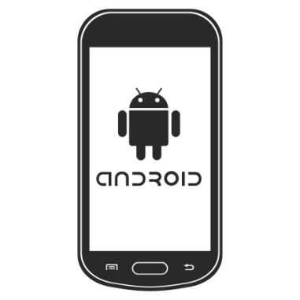
What is Android?
Android is a software stack for mobile devices that includes an operating system, middleware and key applications.
Android is an operating system based on the Linux Operating System.
The project responsible for developing the Android system is called the Android Open Source Project (AOSP) and is primarily lead by Google.

Slide 4
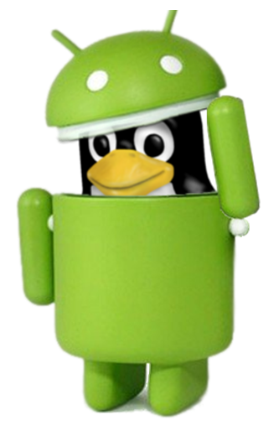
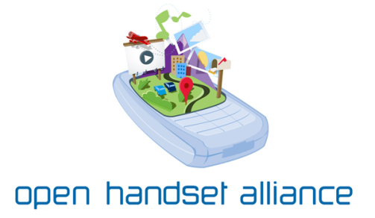
What is Android? (2)
Uses Linux to provide core system services:
Security
Memory management
Process management
Power management
Hardware drivers
An Open Handset Alliance (OHA) project
OHA: The Open Handset Alliance is a consortium of 84 firms to develop open standards for mobile devices

Slide 5
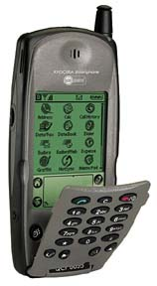
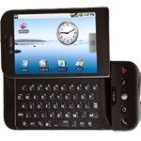
A Short History of Android
2001 Palm Kyocera 6035, combing PDA and phone
2003 - Blackberry Smartphone released
2005
Google acquires startup Android Inc. to start Android platform
Work on Dalvik VM begins
2007
Open Handset Alliance announced
Early look at SDK
June, iPhone released
2008
Google sponsors 1st Android Developer Challenge
T-Mobile G1 announced, released fall
SDK 1.0 released
Android released open source (Apache License)
Android Dev Phone 1 released

Slide 6


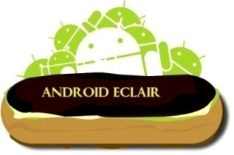


A Short History of Android (2)
2009
SDK 1.5 (Cupcake)
new soft keyboard with “autocomplete” feature
SDK 1.6 (Donut)
support Wide VGA
SDK 2.0/2.0.1/2.1 (Éclair)
revamped UI, browser
2010
Nexus One released to the public
SDK 2.2 (Froyo)
flash support, tethering
SDK 2.3 (Gingerbread)
UI update, system-wide copy-paste

Slide 7

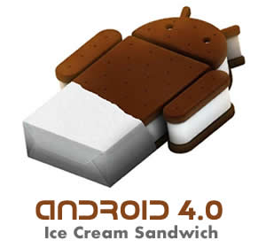

A Short History of Android (3)
2011
SDK 3.0 (Honeycomb) for tablets only
new UI for tablets, support multi-core processors, fragments
SDK 3.1 and 3.2
hardware support and UI improvements
SDK 4.0 (Ice Cream Sandwich)
for Q4, combination of Gingerbread and Honeycomb
Android powers hundreds of millions of mobile devices in more than 190 countries around the world

Slide 8
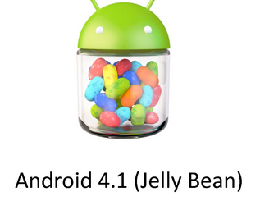
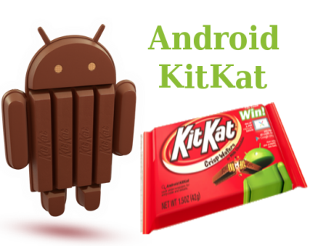
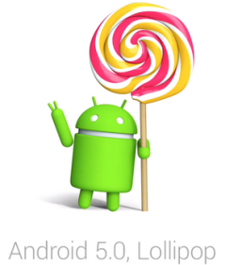
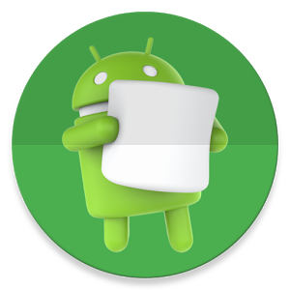
A Short History of Android (4)
2012
Android 4.1, "Jelly Bean" announced late June 2012
2013
Google launched Android 4.4 “KitKat” last September 2013
2014
On November 2014, Android 4.5 or 5.0 “Lollipop” was released
2015
On October 2015 a new version of Android 6.0 and 6.0.1 was released which is called “Marshmallow”

Slide 9
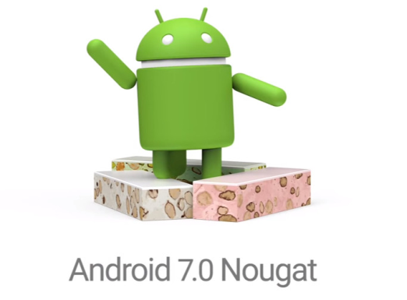
A Short History of Android (5)
2016
Version 7.0 and 7.1.2 “Nougat” was released on 22 August 2016
2017
The latest Android SDK version is 8.0 “Oreo” was announced on 21 August 2017

Slide 10
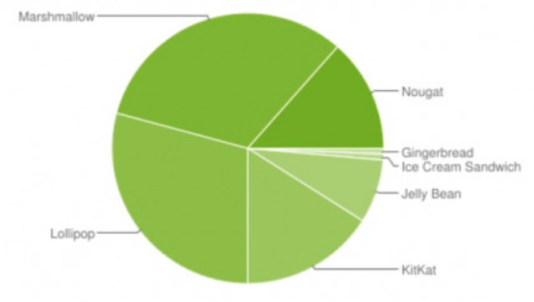
Device Distribution August 2016
2.3 “API 10” Gingerbread 0.7%
4.x “API 15” Ice Cream Sand. 0.7%
4.1.X “API 16” Jelly Bean 2.7%
4.2.X “API 17” Jelly Bean 3.8%
4.3.X “API 18” Jelly Bean 1.1%
4.4 “API 19” KitKat 16.0%
5.0 “API 21” Lollipop 7.4%
5.1 “API 22” Lollipop 21.8%
6.0 “API 23” Marshmallow 32.3%
7.0 “API 24” Nougat 12.3%
7.1 “API 25” Nougat 1.2%
Based on active devices
Forward compatible

Slide 11
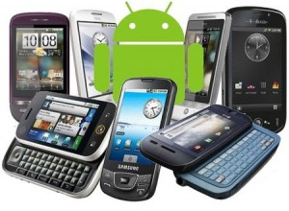
Devices and Apps
Estimated 400M activated devices
1M new activations per day
Google Play (formerly Android Market)
3 million apps in March 2017, after surpassing 1 million apps in July 2013
2/3 free, 1/3 paid
App Store (formerly Apple Market)
1 million app mark at the end of 2013, and Apple currently has around 1.4 million iOS apps available for download
What's old is new - Mac vs. PC
iPhone vs. Android???

Slide 12
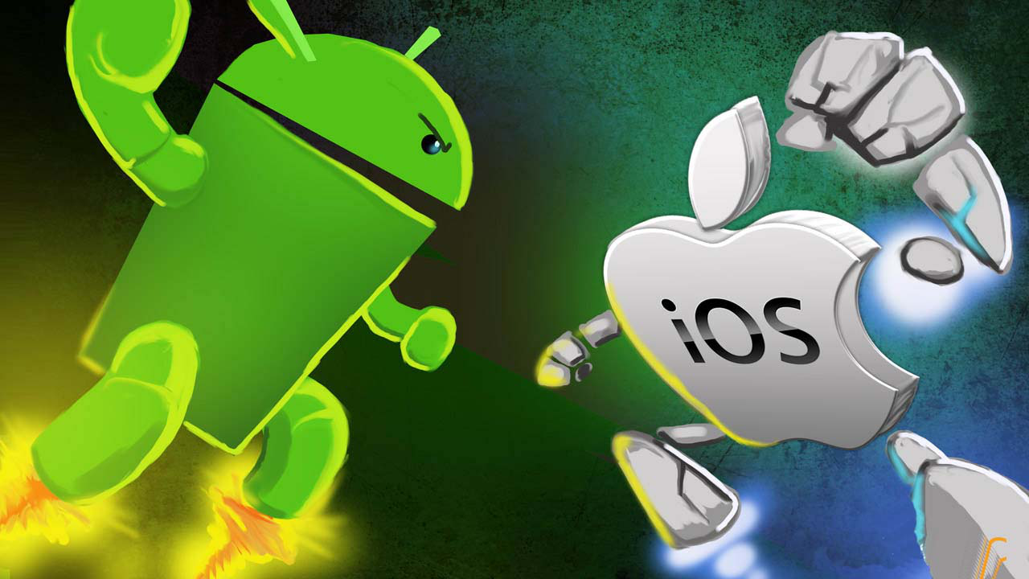
iPhone vs. Android
Notes:
OS: Apple needs Mac, but Android does not required OS
Hardware: Apple need Apple hardware, but Android does not need required Hardware
Language: Apple needs objectiveC/Swift, but Android does not required
Multimedia: Apple requires iTunes, but Android does not required
Network: Android app can make a communication with the other apps, however its really difficult for Apple
Access and complete control over your device is available and you can unlock the bootloader.

Slide 13
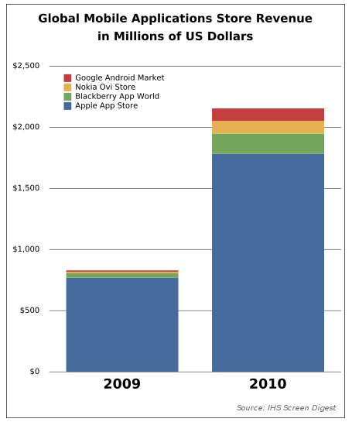
Developer Revenues
Business Strategy:
Attract developers with comparison of revenue generated by applications, average revenue per user, ..etc
Apple has the most high revenue in 2010

Slide 14
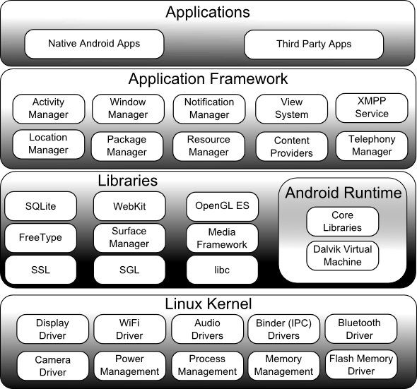
Android Architecture

Slide 15
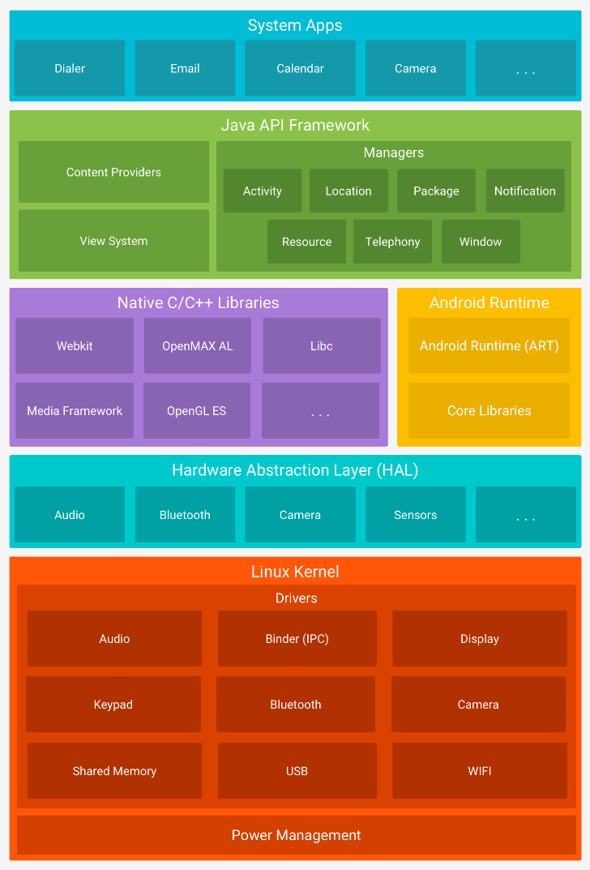
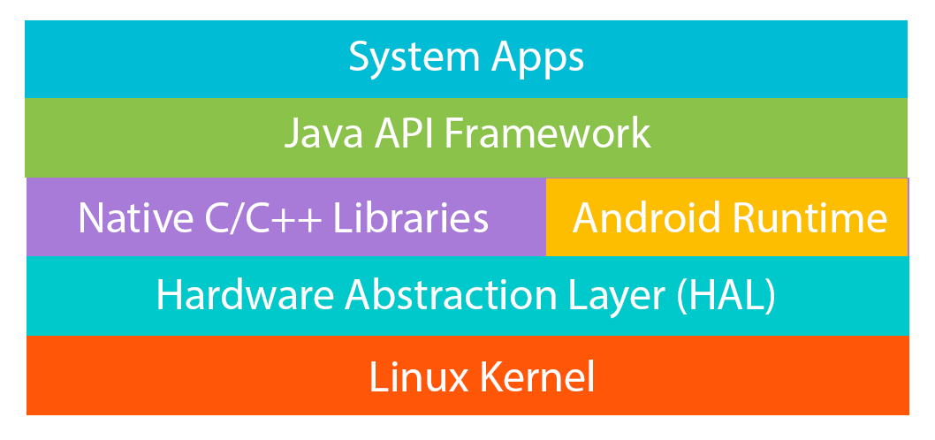
Android Platform Architecture
Android is an open source, Linux-based software stack created for a wide array of devices and form factors.
The following diagram shows the major
components of the Android platform.

Slide 16

Android Platform Architecture

Slide 17
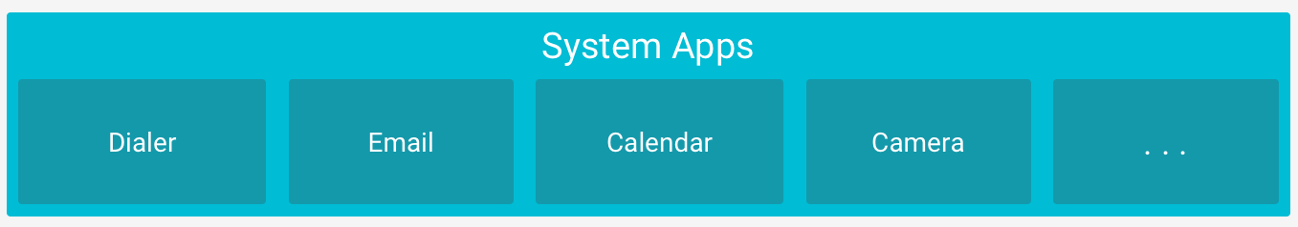
System Apps
Android comes with a set of core apps for email, SMS messaging, calendars, internet browsing, contacts, and more.
Apps included with the platform have no special status among the apps the user chooses to install. Therefor, a third-party app can become the user's default web browser, SMS messenger, or even the default keyboard (some exceptions apply, such as the system's Settings app).

Slide 18
System Apps
The system apps function both as apps for users and to provide key capabilities that developers can access from their own app.
For example, if your app would like to deliver an SMS message, you don't need to build that functionality yourself—you can instead invoke whichever SMS app is already installed to deliver a message to the recipient you specify.

Slide 19
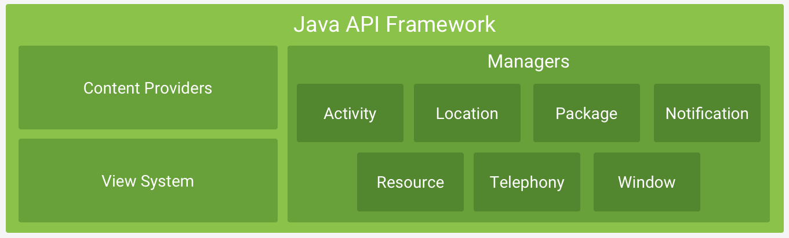
Java API Framework
The entire feature-set of the Android OS is available to you through APIs written in the Java language. These APIs form the building blocks you need to create Android apps by simplifying the reuse of core, modular system components and services.

Slide 20
Java API Framework: System components and services
A rich and extensible View System you can use to build an app’s UI, including lists, grids, text boxes, buttons, and even an embeddable web browser
A Resource Manager, providing access to non-code resources such as localized strings, graphics, and layout files
A Notification Manager that enables all apps to display custom alerts in the status bar
An Activity Manager that manages the lifecycle of apps and provides a common navigation back stack
Content Providers that enable apps to access data from other apps, such as the Contacts app, or to share their own data

Slide 21
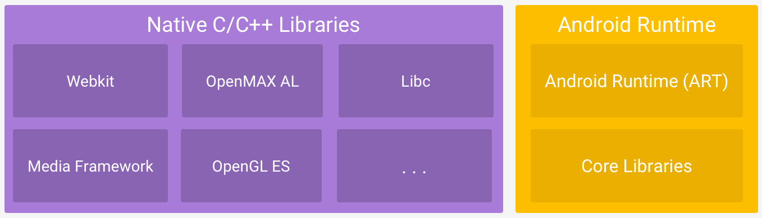
Native C/C++ Libraries
Many core Android system components and services, such as ART and HAL, are built from native code that require native libraries written in C and C++. The Android platform provides Java framework APIs to expose the functionality of some of these native libraries to apps. For example, you can access OpenGL ES through the Android framework’s Java OpenGL API to add support for drawing and manipulating 2D and 3D graphics in your app.

Slide 22
Android Runtime (ART)
Homework!
Submit your answer to the Google Classroom assignment.

Slide 23
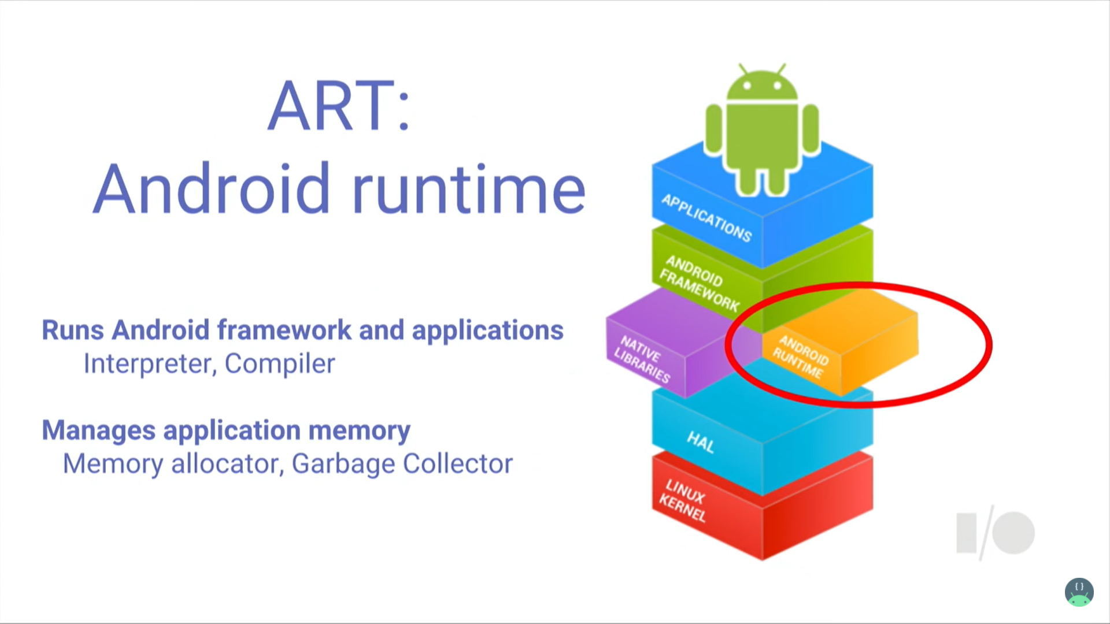
Android Runtime (ART)
Taken From: The Evolution of ART - Google I/O 2016

Slide 24
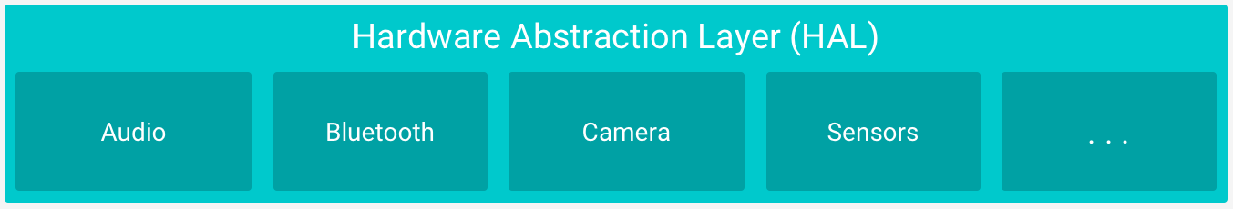
Hardware Abstraction Layer (HAL)
The hardware abstraction layer (HAL) provides standard interfaces that expose device hardware capabilities to the higher-level Java API framework.
The HAL consists of multiple library modules, each of which implements an interface for a specific type of hardware component, such as the camera or bluetooth module. When a framework API makes a call to access device hardware, the Android system loads the library module for that hardware component.

Slide 25
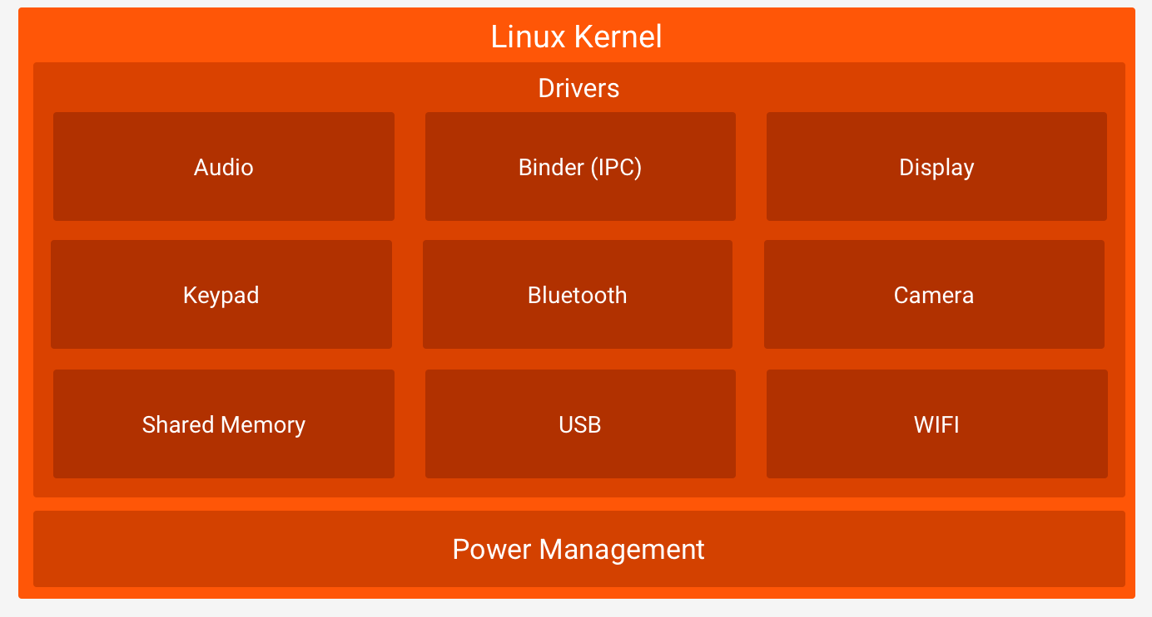
Kernel

Slide 26
Kernel
The foundation of the Android platform is the Linux kernel.
- For example, the Android Runtime (ART) relies on the Linux kernel for underlying functionalities such as threading and low-level memory management.
Using a Linux kernel allows Android to take advantage of key security features and allows device manufacturers to develop hardware drivers for a well-known kernel.

Slide 27
Android Features
Application framework enabling reuse and replacement of components
Optimized Java virtual machine: Dalvik
Optimized Graphics Processing, supporting 2D and 3D graphics (OpenGL ES 1.0 )
Integrated open source web browser: WebKit
SQLite for structured data storage

Slide 28
Android Features (2)
Multimedia capability, supporting varieties of audio, video and still image formats
GSM Telephony
Bluetooth, EDGE, 3G and Wi-Fi support
Camera, GPS, compass, accelerometer and other sensors support
Rich development environment, including an emulator, debugging tools, memory probe tools, log tools and powerful eclipse plug-ins
Notes:
GSM: Global System for Mobile Communication
GPS: Global Positioning System
EDGE: Enhanced Data for Global Evolution

Slide 29

Q & A

